Slide 1
PRESENTATTION
CREATED BY : SYED MUHAMMAD DANIYAL

Slide 2

Save Our Earth

Slide 3
CONTENTS
Issues Causing Environmental Pollution
Small Action Big Difference
Simple Solution With Big Impact

Slide 4
PROBLEMS
POLLUTION
1.
WATER WASTAGE
2.

Slide 5
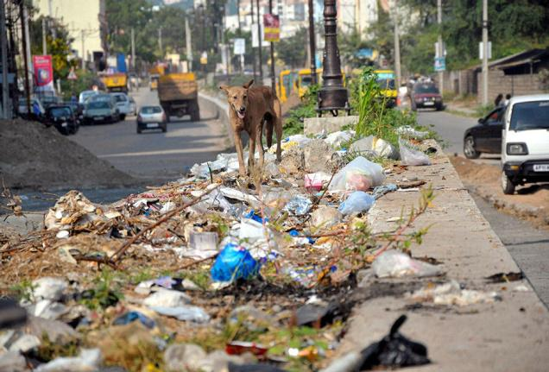
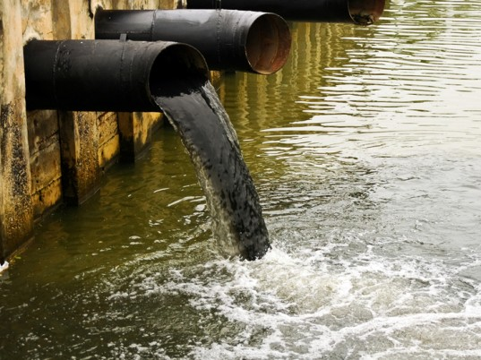
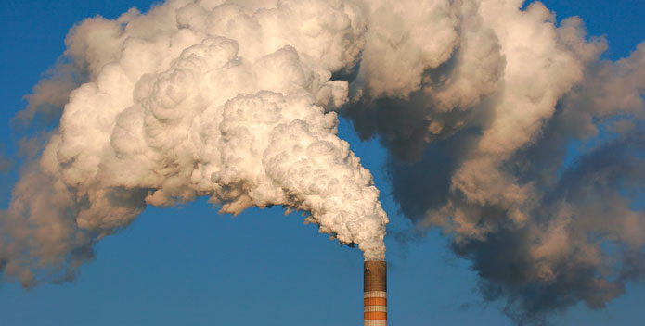
POLLUTION

Slide 6
WHAT IS POLLUTION ????
Pollution can be define as, unpleasant activities in natural environment.
Types of pollution
Air Pollution
Water pollution
Land pollution

Slide 7

What's The Solution

Slide 8
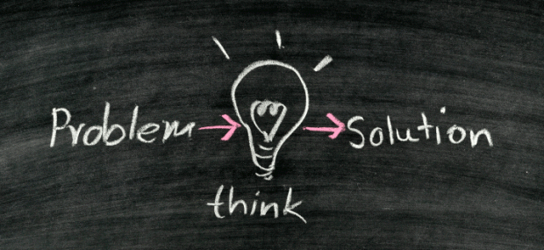


Slide 9
What are the 3 R 's?
The Three R's: Reduce, Reuse and Recycle. The three R's - reduce, reuse and recycle - all help to cut down on the amount of waste we throw away. They conserve natural resources, landfill space and energy.
Reuse
Recycle
Reduce

Slide 10

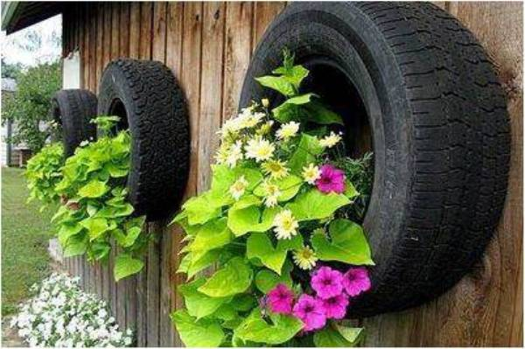
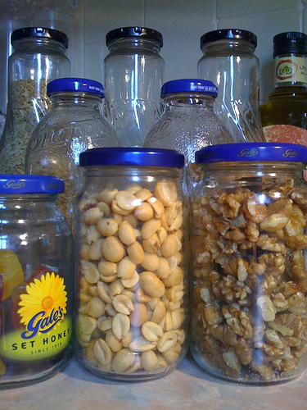
To Reuse is to use an item again after it has been used. This includes conventional reuse where the item is used again for the same function, and creative reuse where it is used for a different function.

Slide 11


The Reduce is that you should limit the number of purchases that you make in the first place. So,
you might limit your household to a single computer.

Slide 12

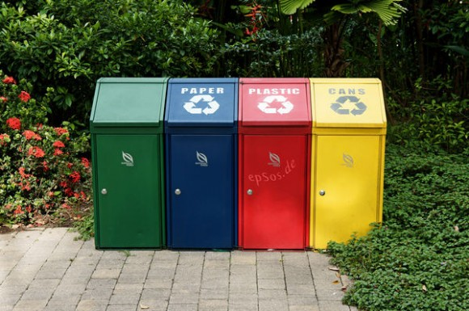
Recycle is to Convert (waste) into reusable material

Slide 13
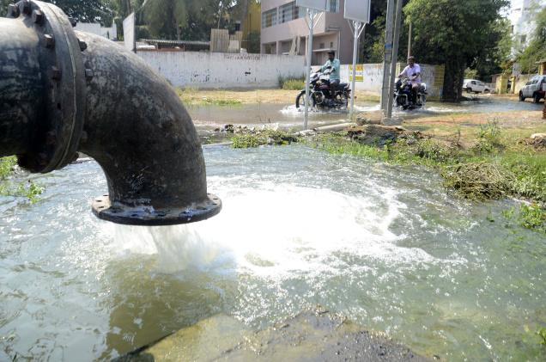
WATER WASTAGE

Slide 14


Water is one of the most important natural resources.
But
People waste water in their homes without even realizing it

Slide 15



Slide 16
We Are our Wasting Our Precious Water

Slide 17

If We do not Use it correctly
Maybe

Slide 18
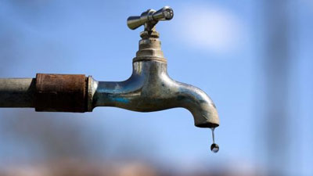
THIRD WORLD WAR WILL BE FOUGHT OVER WATER

Slide 19

So please
save water and save Earth

Slide 20
END PRESENTATION

